Slide 1
Graphics

Slide 2
Lighting Overview

Slide 3
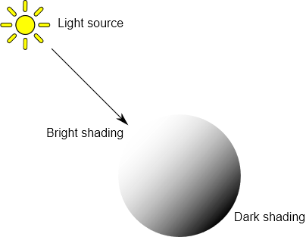
In order to calculate the shading of a 3D object, Unity needs to know the intensity, direction and color of the light that falls on it.

Slide 4
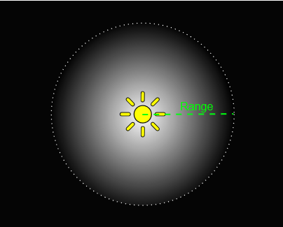
Point Lights

Slide 5
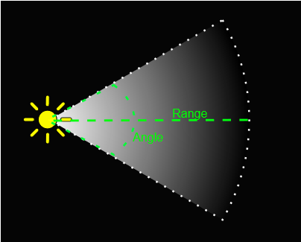
Spot Lights

Slide 6
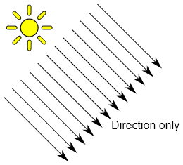
Directional Lights

Slide 7
Area Lights
An Area Light is defined by a rectangle in space
Light is emitted in all directions, but only from one side of the rectangle
The light falls off over a specified range
Since the lighting calculation is quite processor-intensive, area lights are not available at runtime and can only be baked into lightmaps.

Slide 8
Since an area light illuminates an object from several different directions at once, the shading tends to be more soft and subtle than the other light types
You might use it to create a realistic street light or a bank of lights close to the player
A small area light can simulate smaller sources of light (such as interior house lighting) but with a more realistic effect than a point light.

Slide 9
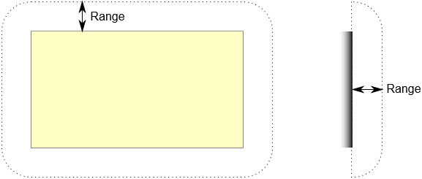

Slide 10
Cookies
In theatre and film, lighting effects have long been used to create an impression of objects that don’t really exist in the set
Jungle explorers may appear to be covered in shadows from an imaginary tree canopy
A prison scene often shows the light coming through the barred window, even though the window and indeed the wall are not really part of the set.
Though very atmospheric, the shadows are created very simply by placing a shaped mask in between the light source and the action
The mask is known as a cucoloris or cookie for short

Slide 11
Creating a Cookie
A cookie is just an ordinary texture but only the alpha/transparency channel is relevant
When you import a cookie, Unity gives you the option to convert the brightness of the image to alpha so it is often easier to design your cookie as a grayscale texture

Slide 12
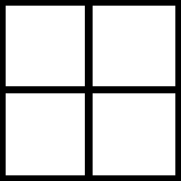

Slide 13
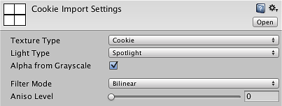
When the cookie is imported into Unity, select it from the Project view and set the Texture Type to Cookie in the inspector
You should also enable Alpha From Grayscale unless you have already designed the image’s alpha channel yourself.

Slide 14
The Light Type affects the way the cookie is projected by the light
Since a point light projects in all directions, the cookie texture must be in the form of a Cubemap
A spot light should use a cookie with the type set to Spotlight but a directional light can actually use either the Spotlight or Directional options
A directional light with a directional cookie will repeat the cookie in a tiled pattern all over the scene
When a spotlight cookie is used, the cookie will appear just once in the direct path of the “beam” of the light; this is the only case where the position of a directional light is important.

Slide 15
Applying a Cookie to a light
When the texture is imported, drag it to the Light’s Cookie property in the inspector to apply it.
The spot light and point light simply scale the cookie according to the size of the cone or sphere
The directional light has an additional option Cookie Size that lets you scale the cookie yourself; the scaling works with both Spotlight and Directional cookie types.

Slide 16
Uses of Cookies
Cookies are often used to change the shape of a light so it matches a detail “painted” in the scene
For example, a dark tunnel may have striplights along the ceiling
If you use standard spot lights for illumination then the beams will have an unexpected round shape but you could use cookies to restrict the lights to a thin rectangle
A monitor screen may cast a green glow onto the face of the character using it but the glow should be restricted to a small box shape.

Slide 17
Note that a cookie need not be completely black and white but can also incorporate any grayscale level
This can be useful for simulating dust or dirt in the path of the light
For example, if a game scene takes place in a long abandoned house, you could add atmosphere by using “dirty” cookies with noise on the windows and other light sources
Similarly, car headlight glass usually contains ridges that create “caustic” patterns of slightly lighter and darker areas in the beam; another good use for a cookie.

Slide 18
Shadows

Slide 19
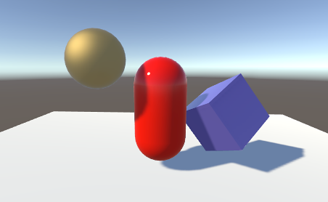
Shadows
Unity’s lights can cast Shadows from an object onto other parts of itself or onto other nearby objects
Shadows add a degree of depth and realism to a scene since they bring out the scale and position of objects that can otherwise look “flat”.

Slide 20
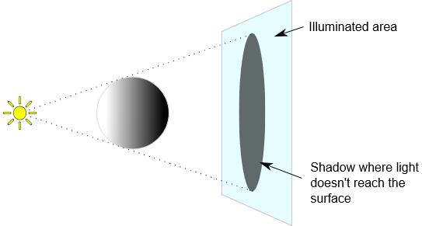
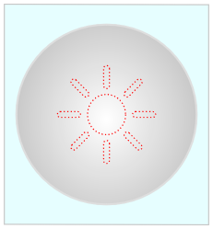
How Do Shadows Work?

Slide 21
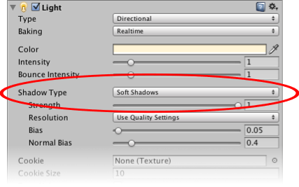
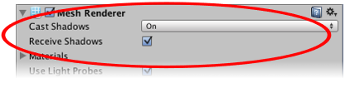
Enabling Shadows

Slide 22
Shadow Mapping and the Bias Property
The shadows for a given light are determined during the final scene rendering
When the scene is rendered to the main view camera, each pixel position in the view is transformed into the coordinate system of the light
The distance of a pixel from the light is then compared to the corresponding pixel in the shadow map
If the pixel is more distant than the shadow map pixel, then it is presumably obscured from the light by another object and it will get no illumination.

Slide 23
A surface directly illuminated by a light can sometimes appear to be partly in shadow
This is because pixels that should be exactly at the distance specified in the shadow map will sometimes be deemed farther away (a consequence of using a low resolution image for the shadow map; or using shadow filtering)
The result is arbitrary patterns of pixels in shadow when they should really be lit, giving a visual effect known as “shadow acne”.

Slide 24
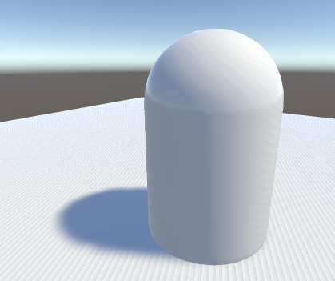

Slide 25
To prevent shadow acne, a bias value can be added to the distance in the shadow map to ensure that pixels on the borderline will definitely pass the comparison as they should; or while rendering into the shadow map, objects can be inset a bit along their normals
These values are set by the Bias and Normal Bias properties in the light’s inspector when it has shadows enabled.
Do not set the Bias value too high though, however, since areas of a shadow near to the object casting it can then sometimes be falsely illuminated
This effect is known as “Peter Panning” (i.e. the disconnected shadow makes the object look as if it is flying above the ground, like Peter Pan).

Slide 26
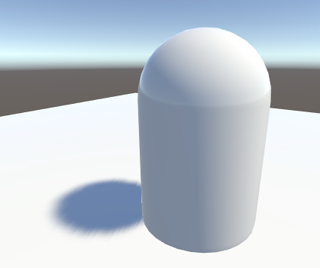

Slide 27
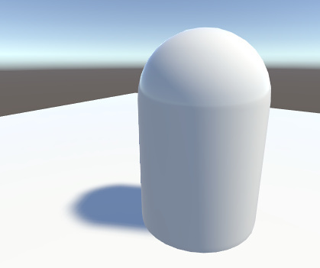
Likewise, setting the Normal Bias value too high will make the shadow appear too narrow for the object:

Slide 28
Directional Light Shadows
A directional light typically simulates sunlight and a single light can illuminate the whole of a scene
This means that the shadow map will often cover a large portion of the scene at once and this makes the shadows susceptible to a problem called “perspective aliasing”
Simply put, perspective aliasing means that shadow map pixels seen close to the camera look enlarged and “chunky” compared to those farther away.

Slide 29
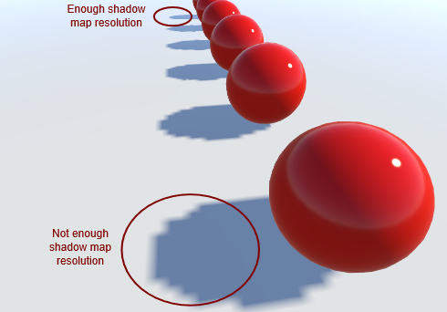

Slide 30
Perspective aliasing is less noticeable when you are using soft shadows and a high resolution for the shadow map
However, using these features will increase demands on the graphics hardware and so framerate might suffer.

Slide 31
Shadow Cascades
The reason perspective aliasing occurs is that different areas of the shadow map are scaled disproportionately by the camera’s perspective
The shadow map from a light needs to cover only the part of the scene visible to the camera, which is defined by the camera’s view frustum
If you imagine a simple case where the directional light comes directly from above, you can see the relationship between the frustum and the shadow map.

Slide 32
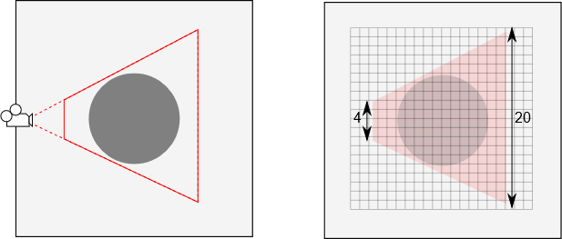

Slide 33
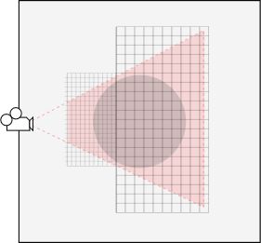

Slide 34
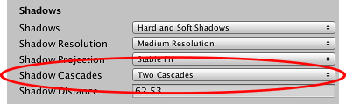
These staged reductions in shadow map size are known as cascaded shadow maps (sometimes called “Parallel Split Shadow Maps”). From the Quality Settings, you can set zero, two or four cascades for a given quality level.
Notes:
The more cascades you use, the less your shadows will be affected by perspective aliasing, but increasing the number does come with a rendering overhead. However, this overhead is still less than it would be if you were to use a high resolution map across the whole shadow.

Slide 35
Shadow Distance
Shadows from objects tend to become less noticeable the farther the objects are from the camera; they appear smaller onscreen and also, distant objects are usually not the focus of attention
Unity lets you take advantage of this effect by providing a Shadow Distance property in the Quality Settings
Objects beyond this distance (from the camera) cast no shadows at all, while the shadows from objects approaching this distance gradually fade out.

Slide 36
Setting the shadow distance as low as possible will help improve rendering performance since distant objects will not need to be rendered into the shadow map at all
Additionally, the scene will often actually look better with distant shadows removed
Getting the shadow distance right is especially important for performance on mobile platforms since they don’t support shadow cascades.

Slide 37
Visualising Shadow Parameter Adjustments
The Scene view has a draw mode called Shadow Cascades that uses coloration to show the parts of the scene using the different cascade levels. You can use this to help you get the shadow distance, cascade count and cascade split ratios just right.

Slide 38
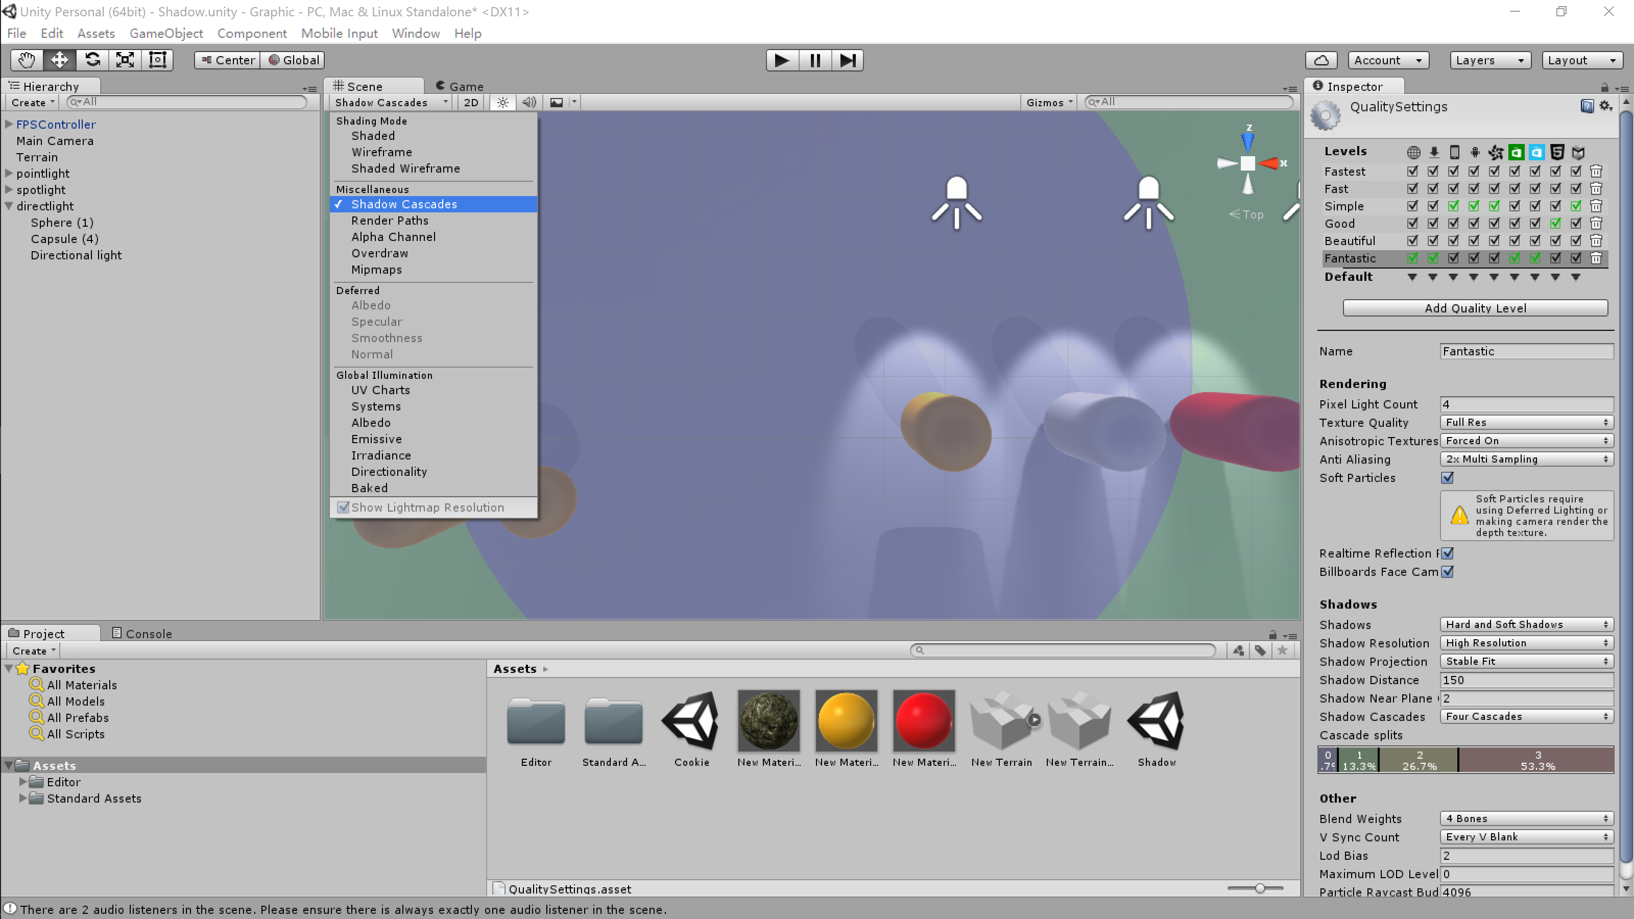

Slide 39
Light Troubleshooting and Performance
Vertex lighting calculates the illumination only at the vertices of meshes and interpolates the vertex values over the rest of the surface. Some lighting effects are not supported by vertex lighting but it is the cheaper of the two methods in terms of processing overhead. Also, this may be the only method available on older graphics cards.
Pixel lighting is calculated separately at every screen pixel. While slower to render, pixel lighting does allow some effects that are not possible with vertex lighting. Normal-mapping, light cookies and realtime shadows are only rendered for pixel lights. Additionally, spotlight shapes and point light highlights look much better when rendered in pixel mode.

Slide 40
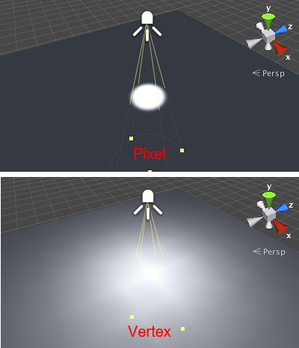

Slide 41
Lights have a big impact on rendering speed, so lighting quality must be traded off against framereate
Since pixel lights have a much higher rendering overhead than vertex lights, Unity will only render the brightest lights at per-pixel quality and render the rest as vertex lights
The maximum number of pixel lights can be set in the Quality Settings for webplayer and standalone build targets

Slide 42
You can favour a light to be rendered as a pixel light using its Render Mode property
A light with the mode set to Important will be given higher priority when deciding whether or not to render it as a pixel light
With the mode set to Auto (the default), Unity will classify the light automatically based on how much a given object is affected by the light
The lights that are rendered as pixel lights are determined on an object-by-object basis.

Slide 43
Shadow performance
Realtime shadows have quite a high rendering overhead, so you should use them sparingly
Any objects that might cast shadows must first be rendered into the shadow map and then that map will be used to render objects that might receive shadows
Enabling shadows has an even bigger impact on performance than the pixel/vertex trade-off mentioned above.

Slide 44
Soft shadows have a greater rendering overhead than hard shadows but this only affects the GPU and does not cause much extra CPU work.

Slide 45
How the Size of a Shadow Map is Calculated
The first step in calculating the size of the map is to determine the area of the screen view that the light can illuminate
For directional lights, the whole screen can be illuminated but for spot lights and point lights, the area is the onscreen projection of the shape of the light’s extent (a sphere for point lights or a cone for spot lights)
The projected shape has a certain width and height in pixels on the screen; the larger of those two values is then taken as the light’s “pixel size”.

Slide 46
When the shadow map resolution is set to High (from the Quality Settings) the shadow map’s size is calculated as follows:
Directional lights: NextPowerOfTwo(pixelSize * 1.9), up to a maximum of 2048.
Spot lights: NextPowerOfTwo(pixelSize), up to a maximum of 1024.
Point lights: NextPowerOfTwo(pixelSize * 0.5), up to a maximum of 512.

Slide 47
If the graphics card has 512MB or more video memory, the upper shadow map limits are increased to 4096 for directional lights, 2048 for spot lights and 1024 for point lights.
At Medium shadow resolution, the shadow map size is half the value for High resolution and for Low, it is a quarter of the size.
Point lights have a lower limit on size than the other types is because they use cubemaps for shadows. That means that six cubemap faces at this resolution must be kept in video memory at once. They are also quite expensive to render, as potential shadow casters might need to be rendered into all six cubemap faces.

Slide 48
Limited Memory Conditions
If your game is running very low on video memory then it will automatically reduce the resolution of shadow maps below the usual value.
Generally, the screen data (backbuffer, frontbuffer, depth buffer) and data for render textures must be held in video memory
The memory needed to store the screen and render texture data will be subtracted from the total available; one third of the remaining video memory will then be reserved for use by shadow maps
The resolution of any given shadow map will be reduced as far as necessary to fit into this space (ie, the calculations given above are still applied but with the reduced resolution).

Slide 49
Assuming all regular textures, vertex data and other graphics objects could be swapped in and out of video memory, the theoretical maximum amount of VRAM that could be used by a shadow map would be given by the formula (TotalVideoMemory - ScreenMemory - RenderTextureMemory)
However, the amounts of memory taken by screen and render textures can never be determined exactly
Furthermore, some objects should not be swapped; performance would suffer badly if all textures were constantly swapped in and out, for example
To allow for this, Unity does not allow a shadow map to exceed one third of “generally available” video memory, and this compromise is found to work quite well in practice.

Slide 50
Troubleshooting Shadows
Old graphics hardware may not support shadows. See below for a list of minimal hardware specs that can handle shadows.
Shadows can be disabled in the Quality Settings. Make sure that you have the correct quality level enabled and that shadows are switched on for that setting.
All Mesh Renderers in the scene must be set up with their Receive Shadows and Cast Shadows correctly set. Both are enabled by default but check that they haven’t been disabled unintentionally.
Only opaque objects cast and receive shadows so objects using the built-in Transparent or Particle shaders will neither cast nor receive. Generally, you can use the Transparent Cutout shaders instead for objects with “gaps” such as fences, vegetation, etc. Custom Shaders must be pixel-lit and use the Geometry render queue.
Objects using VertexLit shaders can’t receive shadows but they can cast them.
With the Forward rendering path, some shaders allow only the brightest directional light to cast shadows (in particular, this happens with Unity’s legacy built-in shaders from 4.x versions). If you want to have more than one shadow-casting light then you should use the Deferred Shading rendering path instead. You can enabled your own shaders to support “full shadows” by using the fullforwardshadows surface shader directive.

Slide 51
Global Illumination

Slide 52
Global Illumination
Global Illumination (GI) is a system that models how light is bounced off of surfaces onto other surfaces (indirect light) rather than being limited to just the light that hits a surface directly from a light source (direct light)
Modelling indirect lighting allows for effects that make the virtual world seem more realistic and connected, since objects affect each other’s appearance
One classic example is ‘color bleeding’ where, for example, sunlight hitting a red sofa will cause red light to be bounced onto the wall behind it
Another is when sunlight hits the floor at the opening of a cave and bounces around inside so the inner parts of the cave are illuminated too.

Slide 53
GI Concepts
Traditionally, video games and other realtime graphics applications have been limited to direct lighting, while the calculations required for indirect lighting were too slow so they could only be used in non-realtime situations such as CG animated films
A way for games to work around this limitation is to calculate indirect light only for objects and surfaces that are known ahead of time to not move around (that are static)
That way the slow computation can be done ahead of time, but since the objects don’t move, the indirect light that is pre-calculated this way will still be correct at runtime
Unity supports this technique, called Baked GI (also known as Baked Lightmaps), which is named after “the bake” - the process in which the indirect light is precalculated and stored (baked)
In addition to indirect light, Baked GI also takes advantage of the greater computation time available to generate more realistic soft shadows from area lights and indirect light than what can normally be achieved with realtime techniques.

Slide 54
Additionally, Unity 5.0 adds support for a new technique called Precomputed Realtime GI
It still requires a precomputation phase similar to the bake mentioned above, and it is still limited to static objects
However it doesn’t just precompute how light bounces in the scene at the time it is built, but rather it precomputes all possible light bounces and encodes this information for use at runtime
So essentially for all static objects it answers the question “if any light hits this surface, where does it bounce to?” Unity then saves this information about which paths light can propagate by for later use
The final lighting is done at runtime by feeding the actual lights present into these previously computed light propagation paths.

Slide 55
This means that the number and type of lights, their position, direction and other properties can all be changed and the indirect lighting will update accordingly
Similarly it’s also possible to change material properties of objects, such as their color, how much light they absorb or how much light they emit themselves.

Slide 56
While Precomputed Realtime GI also results in soft shadows, they will typically have to be more coarse-grained than what can be achieved with Baked GI unless the scene is very small
Also note that while Precomputed Realtime GI does the final lighting at runtime, it does so iteratively over several frames, so if a big a change is done in the lighting, it will take more frames for it to fully take effect
And while this is fast enough for realtime applications, if the target platform has very constrained resources it may be better to use Baked GI for better runtime performance.

Slide 57
Limitations of GI
Both Baked GI and Precomputed Realtime GI have the limitation that only static objects can be included in the bake/precomputation - so moving objects cannot bounce light onto other objects and vice versa. However they can still pick up bounce light from static objects using Light Probes.
Light Probes are positions in the scene where the light is measured (probed) during the bake/precomputation, and then at runtime the indirect light that hits non-static objects is approximated using the values from the probes that the object is closest to at any given moment
So for example a red ball that rolls up next to a white wall would not bleed its color onto the wall, but a white ball next to a red wall could pick up a red color bleed from the wall via the light probes.

Slide 58
Examples of GI Effects
Changing the direction and color of a directional light to simulate the effect of the sun moving across the sky. By modifying the skybox along with the directional light it is possible to create a realistic time-of-day effect that is updated at runtime. (In fact the new built-in procedural skybox makes it easy to do this).
As the day progresses the sunlight streaming in through a window moves across the floor, and this light is realistically bounced around the room and onto the ceiling. When the sunlight reaches a red sofa, the red light is bounced onto the wall behind it. Changing the color of the sofa from red to green will result in the color bleed on the wall behind it turning from red to green too.
Animating the emissiveness of a neon sign’s material so it starts glowing onto its surroundings when it is turned on.

Slide 59
Lighting Window
The Lighting Window (menu: Window > Lighting) is the main control point for Unity’s Global Illumination (GI) features
Although GI in Unity gives good results with default settings, the window’s properties allow you to adjust many aspects of the GI process to customise your scene or optimise for quality, speed and storage space as you need
This window also contains lighting-related settings that were available under the Render Settings in Unity versions prior to 5.0. These include ambient light, halos, cookies and fog.

Slide 60
The controls of the Lighting window are divided among three tabs:
The Object tab lets you choose subsets of the objects in your scene and change settings for them. This is very useful for selecting which objects should participate in the GI computations and also for applying settings consistently to groups of objects.
The Scene tab has settings that apply to the scene overall rather than individual objects. These settings control lighting effects and also optimisation options.
The Lightmaps tab shows the lightmap asset files generated by the GI process.

Slide 61
Lights
For a light object, the Object tab essentially shows the same information as the light component’s standard inspector panel. The properties that specifically affect GI are Baking and Bounce Intensity.
Baking allows you to choose if the light should be baked if Baked GI is selected. Mixed will also bake it, but it will still be present at runtime to give direct lighting to non-static objects. Realtime works both for Precomputed Realtime GI and when not using global illumination.
Bounce Intensity allows you to vary the intensity of indirect light (ie, light that is bounced from one object to another. The value is a multiple of the default brightness calculated by the GI system; if you set Bounce Intensity to a value greater than one then bounced light will be made brighter, while a value less than one will make it dimmer. This is useful, for example, when a dark surface in shadow (such as the interior of a cave) needs to be rendered brighter in order to make detail visible. Or alternatively, if you want to use Precomputed Realtime GI in general, but want to limit a single light to give direct light only, you can set its Bounce Intensity to 0.

Slide 62
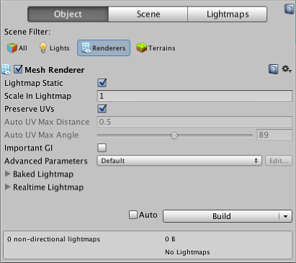
Renderers

Slide 63
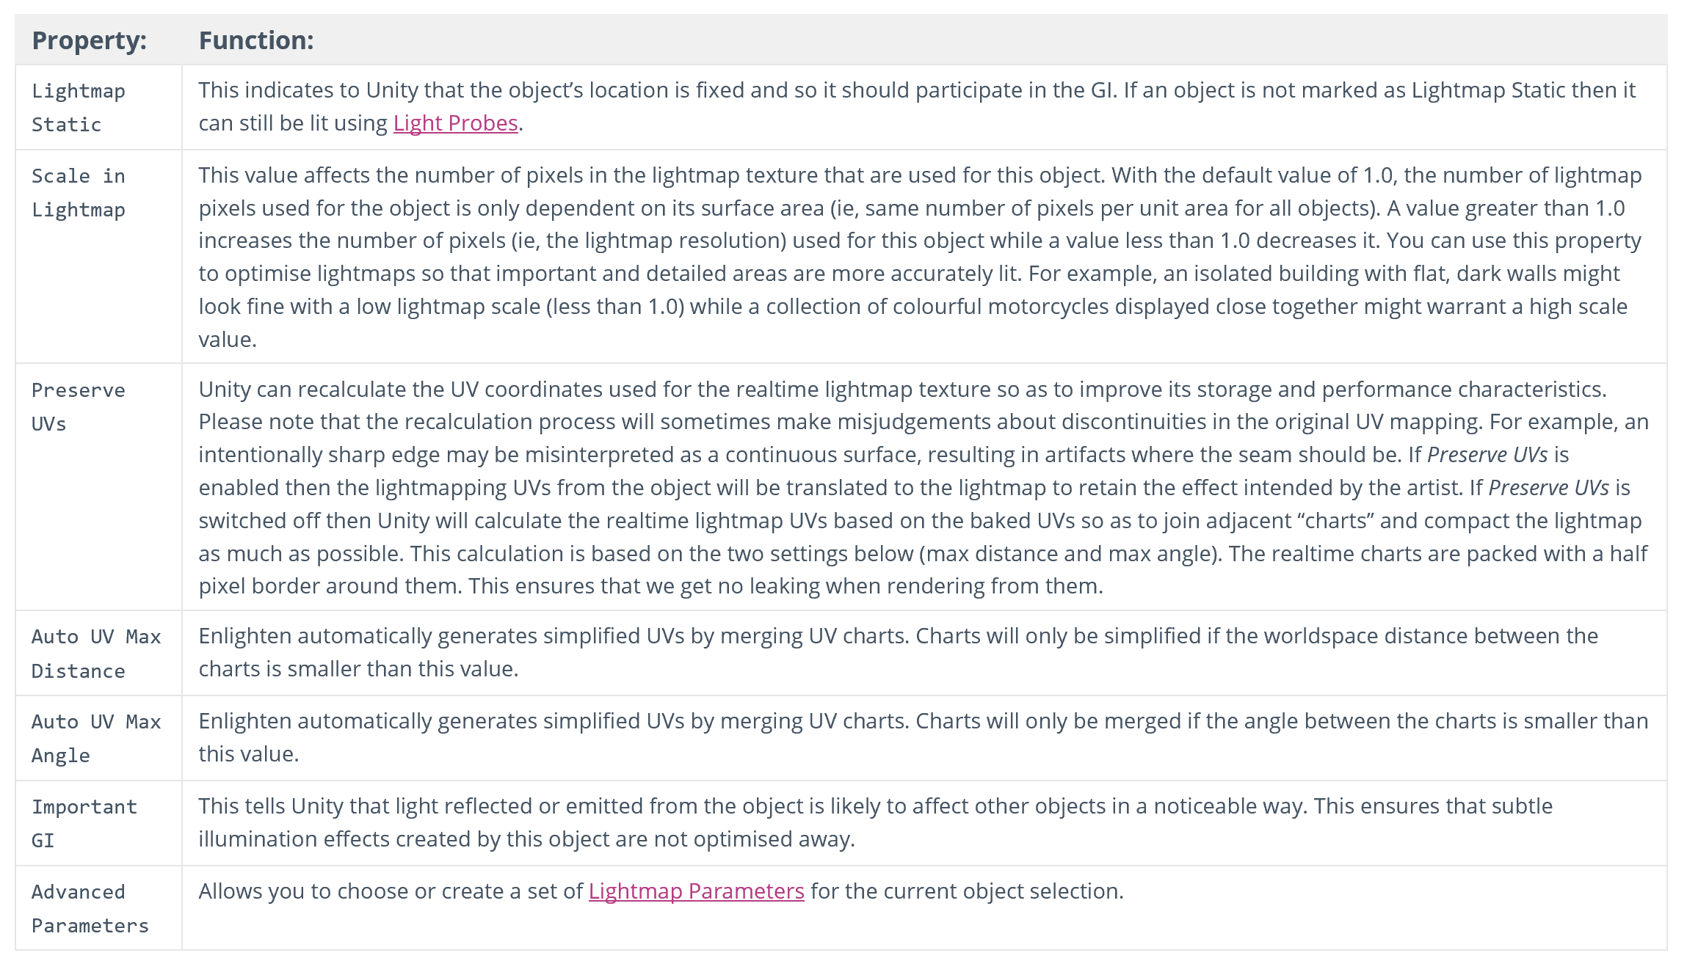

Slide 64
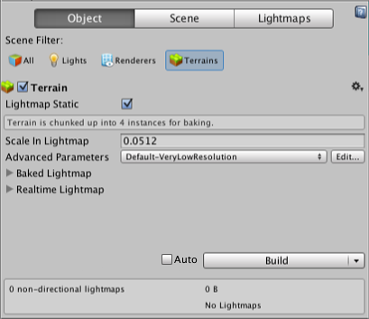
Terrains

Slide 65
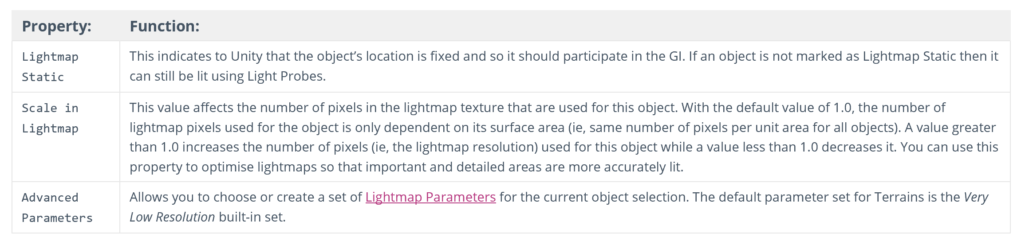

Slide 66
Scene Tab
The Scene tab contains settings that apply to the scene overall as opposed to individual objects
Note that Precomputed Realtime GI and Baked GI features can be enabled or disabled by clicking the checkboxes next to their names in the Scene tab.

Slide 67
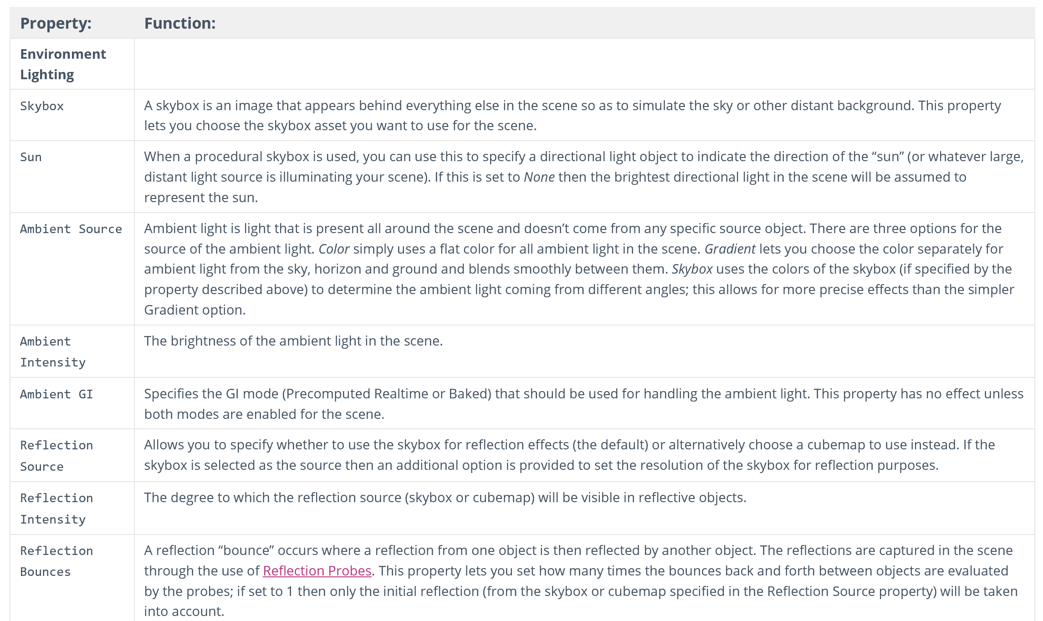

Slide 68
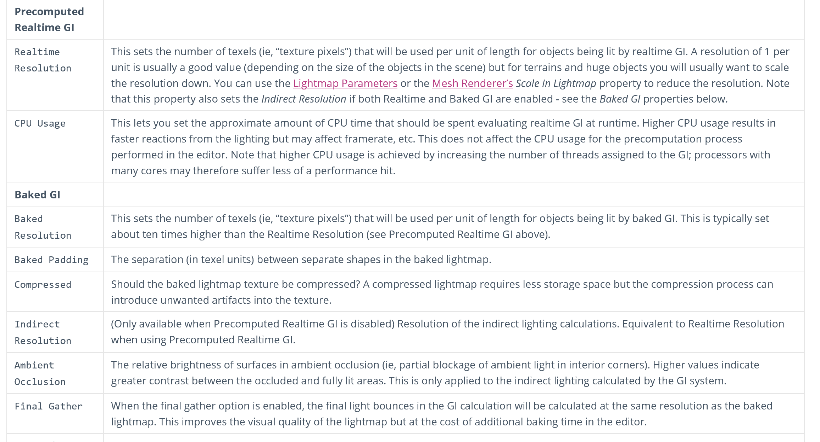

Slide 69
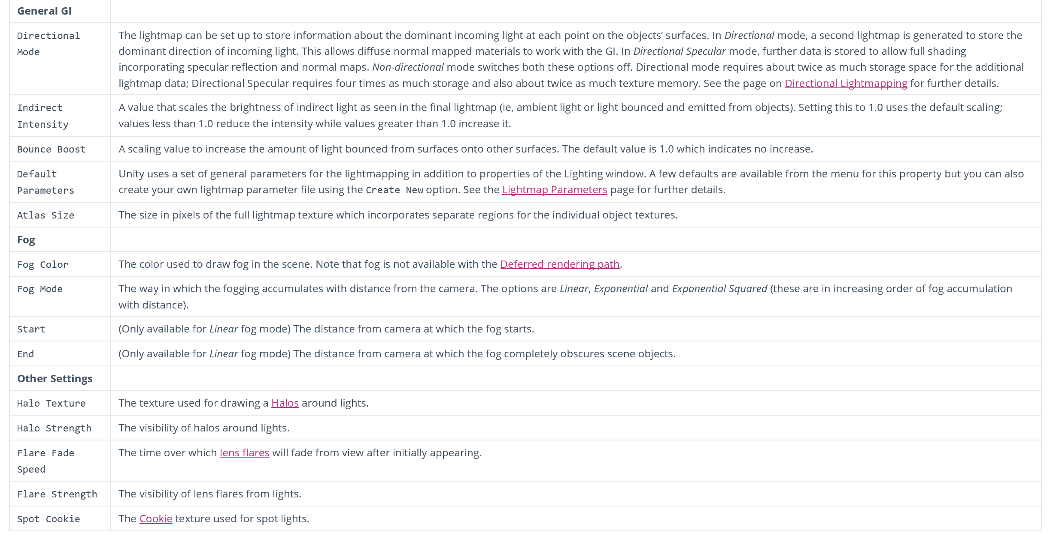

Slide 70
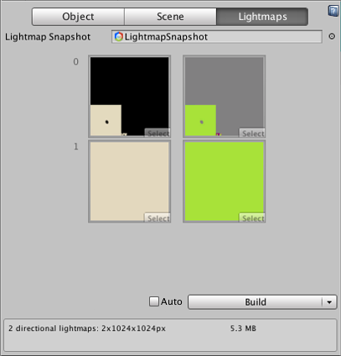
Lightmaps Tab
The final tab provides an easy way to set and locate the lightmap asset file used for the scene.

Slide 71
Light Probes
Although lightmapping adds greatly to the realism of a scene, it has the disadvantage that non-static objects in the scene are less realistically rendered and can look disconnected as a result
It isn’t possible to calculate lightmapping for moving objects in real time but it is possible to get a similar effect using light probes
The idea is that the lighting is sampled at strategic points in the scene, denoted by the positions of the probes
The lighting at any position can then be approximated by interpolating between the samples taken by the nearest probes
The interpolation is fast enough to be used during gameplay and helps avoid the disconnection between the lighting of moving objects and static lightmapped objects in the scene.

Slide 72
Adding Light probes
The Light Probe Group component (menu: Component -> Rendering -> Light Probe Group) can be added to any available object in the scene
The inspector can be used to add new probes to the group
The probes appear in the scene as yellow spheres which can be positioned in the same manner as GameObjects
Selected probes can also be duplicated with the usual keyboard shortcut (ctrl+d/cmd+d).

Slide 73
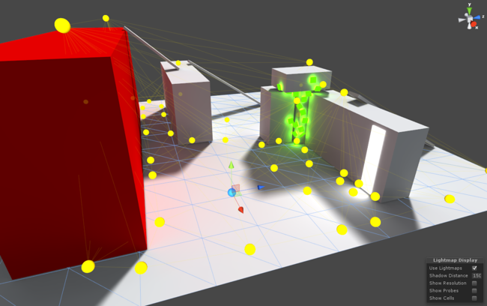

Slide 74
Choosing Light Probe positions
Remember to place probes where you want to sample light or sample darkness
The probes need to form a volume within the scene for the space subdivision to work properly.

Slide 75
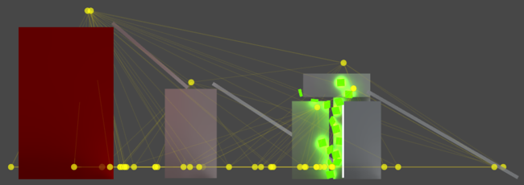
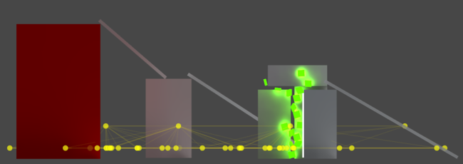
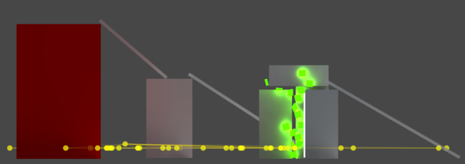
Flat 2D levels
Notes:
Flat 2D levels
As it is now, the light probe system can’t bake a completely flat probe cloud. So even if all your characters move only on a plane, you still have to take care to position at least some probes in a higher layer, so that a volume is formed and interpolation can work properly.
Good: This is the original probe placement. The characters can move up the ramps and up onto the boxes, so it’s good to sample lighting up there as well. Good: Here we assume the characters can only move on the plane. Still, there’s a couple of probes placed a little bit higher, so that a volume is formed and thin cell are avoided. Bad: The probes are placed too flat, which creates really long and thin cells and produces unintuitive interpolation results.

Slide 76
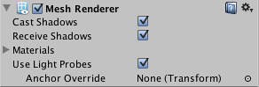
Using Light Probes
To allow a mesh to receive lighting from the probe system, you should enable the Use Light Probes option on its Mesh Renderer:

Slide 77
The probe interpolation requires a point in space to represent the position of the mesh that is receiving light
By default, the centre of the mesh’s bounding box is used but it is possible to override this by dragging a Transform to the Mesh Renderer’s Anchor Override property (this Transform’s position will be used as the interpolation point instead)
This may be useful when an object contains two separate adjoining meshes; if both meshes are lit individually according to their bounding box positions then the lighting will be discontinuous at the place where they join
This can be prevented by using the same Transform (for example the parent or a child object) as the interpolation point for both Mesh Renderers.

Slide 78
When an object using light probes is the active selected object in the Light Probes Scene View mode, its interpolated probe will be rendered on top of it for preview
The interpolated probe is the one used for rendering the object and is connected with 4 thin blue lines (3 when outside of the probe volume) to the probes it is being interpolated between:

Slide 79
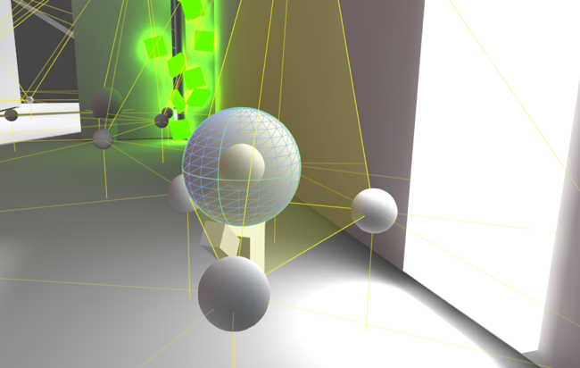

Slide 80
Lightmapping modes
In Single Lightmaps and Directional Lightmaps modes all static lighting (including lights set to ‘Auto’ lightmapping mode) is baked into the light probes.
In Dual Lightmaps mode light probes will store lighting in the same configuration as ‘Near’ lightmaps, i.e. full illumination from sky lights, emissive materials, area lights and ‘Baked Only’ lights, but only indirect illumination from ‘Auto’ lights
Thanks to that the object can be lit in real-time with the ‘Auto’ lights and take advantage of dynamic elements such as real-time shadows, but at the same time receive indirect lighting added to the scene by these lights.

Slide 81
Lightmap Parameters
A Lightmap Parameters asset can be created from the menu in the Project view or from the Scene tab on the Lighting window
The parameters affect the process of generating a lightmap for an object using Unity’s Global Illumination (GI) features
All available Lightmap Parameters assets are listed in the Scene tab of the Lighting window for easy selection
This allows you to create presets optimised for different types of objects or for platforms or different scene types (eg, indoor/outdoor).

Slide 82
Directional Lightmapping
Directional lightmaps store more information about the lighting environment than regular lightmaps
Shaders can use that extra data about incoming light to better calculate outgoing light, which is how materials appear on the screen
This happens at the cost of increased texture memory usage and shading time.
You can choose one of three modes: Non-directional, Directional and Directional with Specular
All three are available as realtime and baked lightmaps.

Slide 83
Non-directional: flat diffuse
This mode uses just a single lightmap, storing information about how much light does the surface emit, assuming it’s purely diffuse
Objects lit this way will appear flat (normalmaps won’t be used) and diffuse (even if the material is specular), but otherwise will be lit correctly.
These barrels are using baked lightmaps.
The only detail definition comes from a reflection probe and an occlusion map.

Slide 84
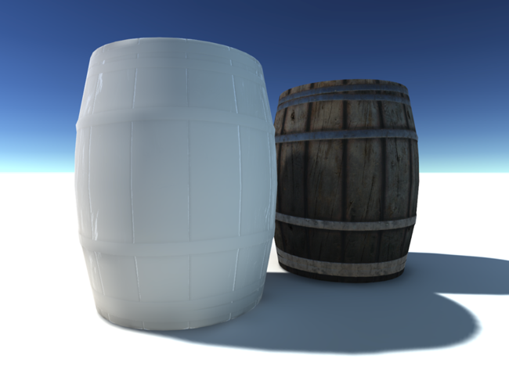

Slide 85
Directional: normalmapped diffuse
This mode adds a secondary lightmap, which stores the incoming dominant light direction and a factor proportional to how much light in the first lightmap is the result of light coming in along the dominant direction
The rest is then assumed to come uniformly from the entire hemisphere
That information allows the material to be normalmapped, but it will still appear purely diffuse.

Slide 86


Slide 87
Directional with Specular: full shading
Like the previous mode, this one uses two lightmaps: light and direction, but this time they’re split in halves
Left side stores direct light, and right indirect
Unlike the two other modes, light is stored as incoming intensity
That extra information allows the shader to run the same BRDF that’s usually reserved for realtime lights, resulting in a full-featured material appearance - now also interacting with indirect light.

Slide 88
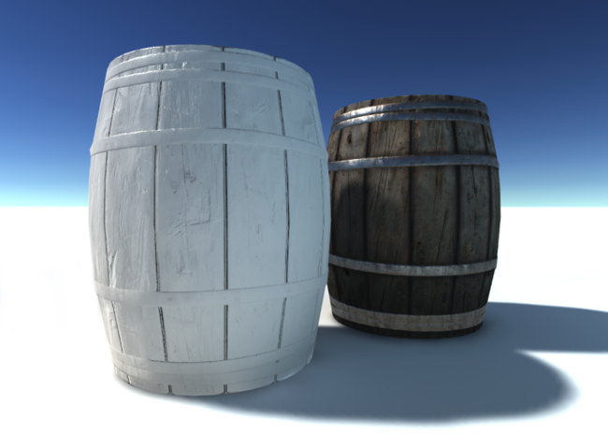

Slide 89
Performance: the Directional mode uses twice as much texture memory as Non-directional lightmaps and has a slightly higher shading cost
Directional with Specular uses twice as much texture memory as Directional (it also uses two textures per set, but they’re split in two, so twice as many sets are needed)
Its shading cost is comparable to two un-shadowed lights, as it runs the BRDF twice - for direct and indirect light
Non-directional: one texture, one texture sample, a few extra shader instructions
Directional: two textures, two texture samples, a few more extra shader instructions. Directional with Specular: two textures, four texture samples, high extra shader cost (about two un-shadowed lights).

Slide 90
Realtime lightmaps take advantage of the same approach, and are subject to the same shading quality/cost tradeoffs
The only difference from the list above is that the Realtime Directional with Specular lightmap uses three textures (incoming intensity, direction, normal), taking three texture samples
It has a shading cost of one un-shadowed light, as it runs the BRDF only once
It works in combination with a realtime direct light, of course, which has its own shading cost.

Slide 91
The BRDF that is actually used for indirect light (Directional with Specular realtime and the indirect part of baked) is a slightly less expensive version. UNITY_BRDF_PBS_LIGHTMAP_INDIRECT is defined in UnityPBSLighting.cginc.
The Directional with Specular mode pushes the lightmapper to the limits of the GI technique it uses, which in some cases leads to artifacts
These are most often patches of incorrect dominant light direction, causing dark or black shading. Some of these issues can be fixed increasing the Realtime/Indirect Resolution. If all else fails, the simpler lightmap modes are more robust.

Slide 92
LightmapSnapshot
The Lightmap Snapshot contains the GI input data and all the intermediate files needed when creating the lightmaps for a scene
The snapshot references the renderers, the realtime lightmaps, the baked lightmaps, light probes, reflection probes and some additional data that describes how they fit together
This also includes all the Enlighten data needed to update the realtime global illumination in the Player
The snapshot is an Editor only construct so far, so you can’t access it in the player
When you change the scene, for instance by breaking a prefab connection on a lightmap static object, the snapshot data will get out of date and has to be rebuilt.

Slide 93
Concerning the rebuild time, this will vary. If your GI Cache is populated i.e. you have done a bake on the machine before (with the scene in its current state) it will be fast
If you are pulling the scene to a machine with a blank cache or the cache data needed has been removed due to the cache size limit, the cache will have to be populated first which requires the precompute and bake processes to run

Slide 94
GI Visualisations in the Scene View
The Scene view has a number of Draw Modes to help you to visualise different aspects of the scene’s content
Among these are a set of modes to let you see exactly what the global illumination is doing
The default Textured mode shows the scene fully lit according to the GI setup
The other modes relevant to the GI are Albedo, Emissive, UV Charts, Irradiance, Directionality, Systems and Baked, each of which is described below
Note that the Object tab in the Lighting window can show the selected object’s texture with the UV channel rendered on top.

Slide 95
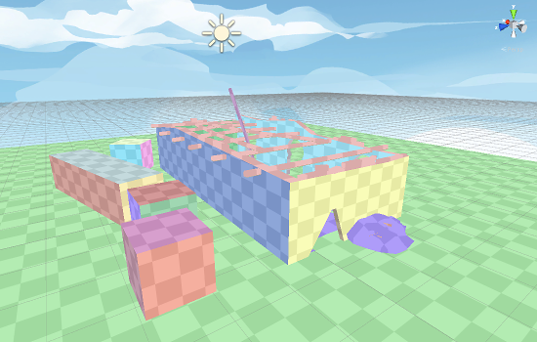
UV Charts
This shows the optimized UV layout used in calculating the dynamic GI
It is automatically generated during the precompute process
It is available as soon as the Instance precompute stage is completed.

Slide 96
Systems
The precompute stage will automatically subdivide the scene into systems (ie, groups of objects sharing the same lightmap atlas) based on proximity and settings
This is mainly done to allow multithreading and optimizations in the precompute process. This visualization shows the systems with different colors.

Slide 97
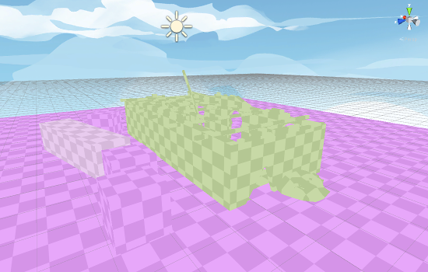

Slide 98
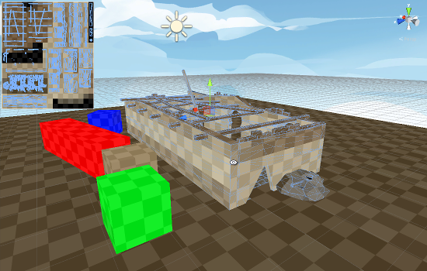
Albedo
This shows the albedo used in calculating the dynamic GI.

Slide 99
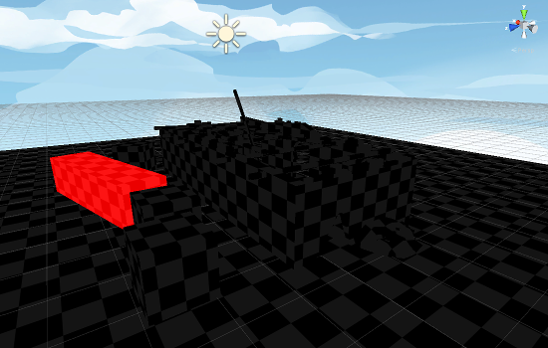
Emissive
Shows the emissiveness used in calculating the dynamic GI.

Slide 100
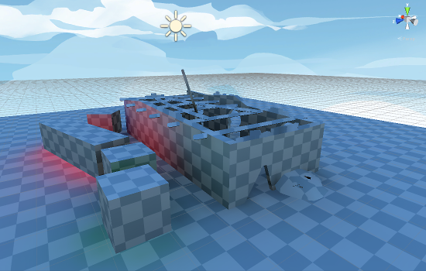
Irradiance
This shows the indirect lighting only (the contents of dynamic lightmaps).

Slide 101
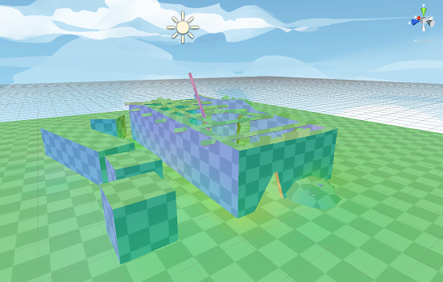
Directionality
This shows directional information matching the irradiance.

Slide 102
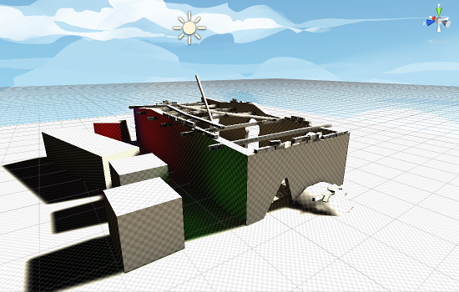
Baked
This shows the baked lightmaps only.

Slide 103
GICache
You can find the settings for the GI Cache in Edit -> Preferences -> GI Cache on Windows and Unity -> Preferences -> GI Cache on Mac OSX
Here you can set the cache size, clear out the current cached files, as well as set a custom cache location.
If nothing in the scene has changed then lighting data should load from the cache in a very short amount of time when reloading your scene.
When the cache size grows larger than the size specified in the prefrences, Unity is spawning a job to trim the least recently used files
If all the files in the cache is in use, because the scene is very large or the cache size is set too low, you need to increase your cache size in the preferences or you will see a lot of recomputation when baking.

Slide 104
It is not safe to delete the GI Cache directory yourself while the Editor is running
The GI Cache folder is created on Editor startup and the Editor maintains a collection of hashes that is used to look up the files in the GI Cache folder
If a file or directory suddenly disappear, the system can’t always recover from the failure and will print an error in the Console… Please use the button in Preferences -> GI Cache -> Clean Cache for clearing the cache directory, as this will ensure that the Editor releases all references to the files on disk before they are deleted.
In the Lighting window, the bake button can expand into a dropdown that lets you clear the baked data if you are in non-continuous baking mode. This will not clear the GI Cache as that would increate bake time afterwards.
It is of course possible to share the GI Cache folder via some other means, this would make lightmap snapshot rebuild faster.

Slide 105
Linear Rendering

Slide 106
Linear rendering refers to the process of rendering a scene with all inputs being linear
Normally textures exist with gamma correction pre-applied to them, which means that when the textures are sampled in a material the values are not linear
If these textures are used in the usual equations for e.g. lighting and image effect it will lead to slightly wrong results as the equations are calculated in a non-linear space.
Linear rendering ensures that both inputs and outputs of a shader are in the correct color space which results in a more correct outcome.

Slide 107
Gamma Pipeline
In the gamma rendering pipeline all colors and textures are sampled in gamma space, ie, gamma correction is not removed from images or colors before they are used in a shader
Albeit these values being in gamma space, all shader calculations treat their input as if it was in linear space, and additionally, when writing the shader outputs to memory, no gamma correction is applied to the final pixel
Much of the time this looks acceptable as the two wrongs go some way to cancelling each other out. But it is not correct.

Slide 108
Linear Pipeline
If linear rendering is enabled then inputs to the shader program are supplied with the gamma correction removed from them
For colors this conversion is applied implicitly if you are in linear space
Textures are sampled using hardware sRGB reads; the source texture is supplied in gamma space and then on sampling in the graphics hardware the result is converted automatically
These inputs are then supplied to the shader and lighting occurs as it normally would
When writing the resulting value to the framebuffer, it will either be gamma corrected or left in linear space for later gamma correction; this depends on the current rendering configuration.

Slide 109
Differences Between Linear and Gamma Rendering
When using linear rendering, input values to the shader equations are different than in gamma space
This means that e.g. lights striking surfaces will have a different response curve and image effects will behave differently than in the gamma pipeline.

Slide 110
Light Falloff
The falloff from distance- and normal-based lighting is changed in two ways
Firstly when rendering in linear mode, the additional gamma correction that is performed will make a light’s radius appear larger
Secondly lighting edges will also be harsher. This more correctly models lighting intensity falloff on surfaces.

Slide 111
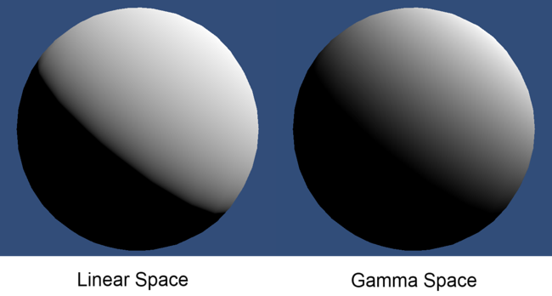

Slide 112
Linear Intensity Response
When you are using gamma rendering, the colors and textures that are supplied to a shader have a gamma correction applied to them
When they are used in a shader the colors of high luminance are actually brighter then they should be for linear lighting
This means that as light intensity increases the surface will get brighter in a non linear way
This leads to lighting that can be too bright in many places, and can also give models and scenes a washed-out feel
When you are using linear rendering, the response from the surface remains linear as the light intensity increases. This leads to much more realistic surface shading and a much nicer color response in the surface.

Slide 113
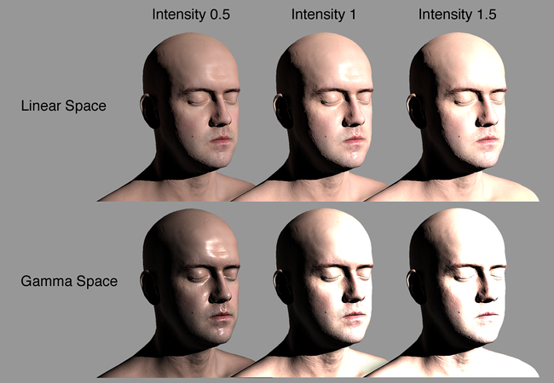
Notes:
Infinite 3D Head Scan by Lee Perry-Smith is licensed under a Creative Commons Attribution 3.0 Unported License. Available from: http://www.ir-ltd.net/

Slide 114
Linear and Gamma Blending
When performing blending into the framebuffer, the blending occurs in the color space of the framebuffer
When using gamma rendering, this means that non-linear colors get blended together. This is incorrect
When using linear space rendering, blending occurs in linear space. This is correct and gives the expected results.

Slide 115
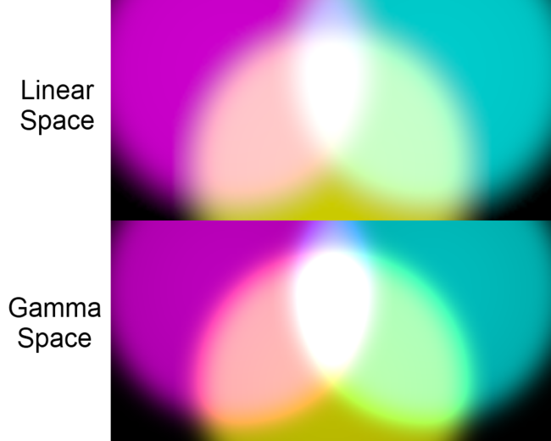

Slide 116
Using Linear Rendering
Linear rendering gives a different look to the rendered scene
When you have authored a project for rendering in gamma space, at first it will most likely not look correct if you change to linear rendering
Because of this, if you move to linear rendering from gamma rendering it may take some time to update the project so that it looks as good as before, but the switch ultimately enables more consistent and realistic rendering
That being said, enabling linear rendering in Unity is simple: It is implemented on a per-project basis and is exposed in the Player Settings which can be located at Edit -> Project Settings -> Player -> Other Settings

Slide 117
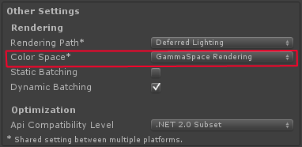

Slide 118
Lightmapping
When you are using linear rendering, all lighting and textures are linearized, which means that the values passed to the lightmapper also need to be modified
Thus, when you switch between gamma and linear rendering, you will need to rebake lightmaps
This happens automatically when Unity’s lighting is set to auto bake (which is the default).

Slide 119
Linear and Non HDR
When you are not using HDR, a special framebuffer type is used that supports sRGB read and sRGB write (Degamma on read, Gamma on write)
This means that just like a texture, the values in the framebuffer are gamma corrected
When this framebuffer is used for blending or bound as texture, the values have the gamma removed before being used
When these buffers are written to, the value that is being written is converted from linear space to gamma space
If you are rendering in linear mode then all post-process effects will have their source and target buffers created with sRGB reading and writing enabled so that post-processing and post-process blending occurs in linear space.

Slide 120
Linear and HDR
When using HDR, rendering is performed into floating point buffers
These buffers have enough resolution not to require conversion to and from gamma space whenever the buffer is accessed
This means that when rendering in linear mode, the render targets you use will store the colors in linear space
Therefore, all blending and post process effects will implicitly be performed in linear space. When the the backbuffer is written to, gamma correction is applied.

Slide 121
Cameras

Slide 122
A Unity scene is created by arranging and moving objects in a three-dimensional space. Since the viewer’s screen is two-dimensional, there needs to be a way to capture a view and “flatten” it for display. This is accomplished using Cameras.
A camera is an object that defines a view in scene space. The object’s position defines the viewpoint, while the forward (Z) and upward (Y) axes of the object define the view direction and the top of the screen, respectively
The Camera component also defines the size and shape of the region that falls within the view. With these parameters set up, the camera can display what it currently “sees” to the screen. As the camera object moves and rotates, the displayed view will also move and rotate accordingly.

Slide 123
Perspective and orthographic cameras
A camera in the real world, or indeed a human eye, sees the world in a way that makes objects look smaller the farther they are from the point of view. This well-known perspective effect is widely used in art and computer graphics and is important for creating a realistic scene
Naturally, Unity supports perspective cameras, but for some purposes, you want to render the view without this effect. For example, you might want to create a map or information display that is not supposed to appear exactly like a real-world object
A camera that does not diminish the size of objects with distance is referred to as orthographic and Unity cameras also have an option for this

Slide 124
The shape of the viewed region
Both perspective and orthographic cameras have a limit on how far they can “see” from their current position
The limit is defined by a plane that is perpendicular to the camera’s forward (Z) direction
This is known as the far clipping plane since objects at a greater distance from the camera are “clipped” (ie, excluded from rendering)
There is also a corresponding near clipping plane close to the camera - the viewable range of distance is that between the two planes.

Slide 125
Without perspective, objects appear the same size regardless of their distance
This means that the viewing volume of an orthographic camera is defined by a rectangular box extending between the two clipping planes.

Slide 126
When perspective is used, objects appear to diminish in size as the distance from camera increases
The viewing volume of a perspective camera, then, is not a box but a pyramidal shape with the apex at the camera’s position and the base at the far clipping plane
The shape is not exactly a pyramid, however, because the top is cut off by the near clipping plane; this kind of truncated pyramid shape is known as a frustum
Since its height is not constant, the frustum is defined by the ratio of its width to its height (known as the aspect ratio) and the angle between the top and bottom at the apex (known as the field of view of FOV)

Slide 127
The background to the camera view
For indoor scenes, the camera may always be completely inside some object representing the interior of a building, cave or other structure
When the action takes place outdoors, however, there will be many empty areas in between objects that are filled with nothing at all; these background areas typically represent the sky, space or the murky depths of an underwater scene.

Slide 128
A camera can’t leave the background completely undecided and so it must fill in the empty space with something
The simplest option is to clear the background to a flat color before rendering the scene on top of it
You can set this color using the camera’s Background property, either from the inspector or from a script
A more sophisticated approach that works well with outdoor scenes is to use a Skybox
The most common usage is to represent the sky in a standard outdoor scene but the box actually surrounds the camera completely, even underneath. This means that you can use a skybox to represent parts of the scene (eg, rolling plains that stretch beyond the horizon) or the all-round view of a scene in space or underwater.

Slide 129
Using more than one camera
When created, a Unity scene contains just a single camera and this is all you need for most situations
However, you can have as many cameras in a scene as you like and their views can be combined in different ways

Slide 130
Switching cameras
By default, a camera renders its view to cover the whole screen and so only one camera view can be seen at a time (the visible camera is the one that has the highest value for its depth property)
By disabling one camera and enabling another from a script, you can “cut” from one camera to another to give different views of a scene

Slide 131
using UnityEngine;
using System.Collections;
public class ExampleScript : MonoBehaviour {
public Camera firstPersonCamera;
public Camera overheadCamera;
public void ShowOverheadView() {
firstPersonCamera.enabled = false;
overheadCamera.enabled = true;
}
public void ShowFirstPersonView() {
firstPersonCamera.enabled = true;
overheadCamera.enabled = false;
}
}

Slide 132
Rendering a small camera view inside a larger one
Usually, you want at least one camera view covering the whole screen (the default setting) but it is often useful to show another view inside a small area of the screen
For example, you might show a rear view mirror in a driving game or show an overhead mini-map in the corner of the screen while the main view is first-person
You can set the size of a camera’s onscreen rectangle using its Viewport Rect property.
The coordinates of the viewport rectangle are “normalized” with respect to the screen. The bottom and left edges are at the 0.0 coordinate, while the top and right edges are at 1.0. A coordinate value of 0.5 is halfway across
In addition to the viewport size, you should also set the depth property of the camera with the smaller view to a higher value than the background camera
The exact value does not matter but the rule is that a camera with a higher depth value is rendered over one with a lower value.

Slide 133
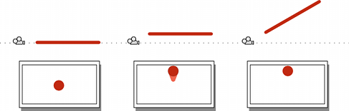
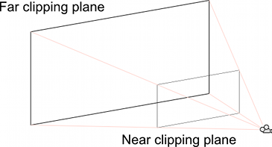
Understanding the View Frustum

Slide 134
Dolly Zoom
Dolly Zoom is the well-known visual effect where the camera simultaneously moves towards a target object and zooms out from it
The result is that the object appears roughly the same size but all the other objects in the scene change perspective
Done subtly, dolly zoom has the effect of highlighting the target object, since it is the only thing in the scene that isn’t shifting position in the image

Slide 135

Creating the effect in code is a matter of saving the height of the frustum at the object’s position at the start of the zoom. Then, as the camera moves, its new distance is found and the FOV adjusted to keep it the same height at the object’s position. This can be accomplished with the following code:

Slide 136
using UnityEngine;
using System.Collections;
public class ExampleScript : MonoBehaviour {
public Transform target;
public Camera camera;
private float initHeightAtDist;
private bool dzEnabled;
// Calculate the frustum height at a given distance from the camera.
void FrustumHeightAtDistance(float distance) {
return 2.0f * distance * Mathf.Tan(camera.fieldOfView * 0.5f * Mathf.Deg2Rad);
}
// Calculate the FOV needed to get a given frustum height at a given distance.
void FOVForHeightAndDistance(float height, float distance) {
return 2.0f * Mathf.Atan(height * 0.5f / distance) * Mathf.Rad2Deg;
}
// Start the dolly zoom effect.
void StartDZ() {
var distance = Vector3.Distance(transform.position, target.position);
initHeightAtDist = FrustumHeightAtDistance(distance);
dzEnabled = true;
}
// Turn dolly zoom off.
void StopDZ() {
dzEnabled = false;
}
void Start() {
StartDZ();
}
void Update () {
if (dzEnabled) {
// Measure the new distance and readjust the FOV accordingly.
var currDistance = Vector3.Distance(transform.position, target.position);
camera.fieldOfView = FOVForHeightAndDistance(initHeightAtDist, currDistance);
}
// Simple control to allow the camera to be moved in and out using the up/down arrows.
transform.Translate(Input.GetAxis("Vertical") * Vector3.forward * Time.deltaTime * 5f);
}
}

Slide 137
Rays from the Camera

Slide 138
Rays from the Camera
The Ray always corresponds to a point in the view, so the Camera class provides the ScreenPointToRay and ViewportPointToRay functions
The difference between the two is that ScreenPointToRay expects the point to be provided as a pixel coordinate, while ViewportPointToRay takes normalized coordinates in the range 0..1 (where 0 represents the bottom or left and 1 represents the top or right of the view)
Each of these functions returns a Ray which consists of a point of origin and a vector which shows the direction of the line from that origin. The Ray originates from the near clipping plane rather than the Camera’s transform.position point.

Slide 139
Raycasting
The most common use of a Ray from the camera is to perform a raycast out into the scene
A raycast sends an imaginary “laser beam” along the ray from its origin until it hits a collider in the scene
Information is then returned about the object and the point that was hit in a RaycastHit object
This is a very useful way to locate an object based on its onscreen image
For example, the object at the mouse position can be determined with the following code:

Slide 140
using UnityEngine;
using System.Collections;
public class ExampleScript : MonoBehaviour {
public Camera camera;
void Start(){
RaycastHit hit;
Ray ray = camera.ScreenPointToRay(Input.mousePosition);
if (Physics.Raycast(ray, out hit)) {
Transform objectHit = hit.transform;
// Do something with the object that was hit by the raycast.
}
}
}

Slide 141
Moving the Camera Along a Ray
It is sometimes useful to get a ray corresponding to a screen position and then move the camera along that ray
For example, you may want to allow the user to select an object with the mouse and then zoom in on it while keeping it “pinned” to the same screen position under the mouse (this might be useful when the camera is looking at a tactical map, for example)
The code to do this is fairly straightforward:

Slide 142
using UnityEngine;
using System.Collections;
public class ExampleScript : MonoBehaviour {
public bool zooming;
public float zoomSpeed;
public Camera camera;
void Update() {
if (zooming) {
Ray ray = camera.ScreenPointToRay(Input.mousePosition);
float zoomDistance = zoomSpeed * Input.GetAxis("Vertical") * Time.deltaTime;
camera.transform.Translate(ray.direction * zoomDistance, Space.World);
}
}
}

Slide 143
Using an Oblique Frustum

Slide 144
By default, the view frustum is arranged symmetrically around the camera’s centre line but it doesn’t necessarily need to be
The frustum can be made “oblique”, which means that one side is at a smaller angle to the centre line than the opposite side
The effect is rather like taking a printed photograph and cutting one edge off
This makes the perspective on one side of the image seem more condensed giving the impression that the viewer is very close to the object visible at that edge
An example of how this can be used is a car racing game where the frustum might be flattened at its bottom edge
This would make the viewer seem closer to the road, accentuating the feeling of speed.

Slide 145

While the camera class doesn’t have functions to set the obliqueness of the frustum, it can be done quite easily by altering the projection matrix:

Slide 146
using UnityEngine;
using System.Collections;
public class ExampleScript : MonoBehaviour {
void SetObliqueness(float horizObl, float vertObl) {
Matrix4x4 mat = Camera.main.projectionMatrix;
mat[0, 2] = horizObl;
mat[1, 2] = vertObl;
Camera.main.projectionMatrix = mat;
}
}
Notes:
Mercifully, it is not necessary to understand how the projection matrix works to make use of this. The horizObl and vertObl values set the amount of horizontal and vertical obliqueness, respectively. A value of zero indicates no obliqueness. A positive value shifts the frustum rightwards or upwards, thereby flattening the left or bottom side. A negative value shifts leftwards or downwards and consequently flattens the right or top side of the frustum. The effect can be seen directly if this script is added to a camera and the game is switched to the scene view while the game runs; the wireframe depiction of the camera’s frustum will change as you vary the values of horizObl and vertObl in the inspector. A value of 1 or –1 in either variable indicates that one side of the frustum is completely flat against the centreline. It is possible although seldom necessary to use values outside this range.

Slide 147
Occlusion Culling

Slide 148
Occlusion Culling is a feature that disables rendering of objects when they are not currently seen by the camera because they are obscured (occluded) by other objects
This does not happen automatically in 3D computer graphics since most of the time objects farthest away from the camera are drawn first and closer objects are drawn over the top of them (this is called “overdraw”)
Occlusion Culling is different from Frustum Culling. Frustum Culling only disables the renderers for objects that are outside the camera’s viewing area but does not disable anything hidden from view by overdraw
Note that when you use Occlusion Culling you will still benefit from Frustum Culling.

Slide 149

A maze-like indoor level. This normal scene view shows all visible Game Objects.

Slide 150

Regular frustum culling only renders objects within the camera’s view. This is automatic and always happens.

Slide 151

Occlusion culling removes additional objects from within the camera rendering work if they are entirely obscured by nearer objects.

Slide 152
The occlusion culling process will go through the scene using a virtual camera to build a hierarchy of potentially visible sets of objects
This data is used at runtime by each camera to identify what is visible and what is not
Equipped with this information, Unity will ensure only visible objects get sent to be rendered
This reduces the number of draw calls and increases the performance of the game.

Slide 153
The data for occlusion culling is composed of cells
Each cell is a subdivision of the entire bounding volume of the scene
More specifically the cells form a binary tree
Occlusion Culling uses two trees, one for View Cells (Static Objects) and the other for Target Cells (Moving Objects)
View Cells map to a list of indices that define the visible static objects which gives more accurate culling results for static objects.

Slide 154
It is important to keep this in mind when creating your objects because you need a good balance between the size of your objects and the size of the cells
Ideally, you shouldn’t have cells that are too small in comparison with your objects but equally you shouldn’t have objects that cover many cells
You can sometimes improve the culling by breaking large objects into smaller pieces
However, you can still merge small objects together to reduce draw calls and, as long as they all belong to the same cell, occlusion culling will not be affected
The collection of cells and the visibility information that determines which cells are visible from any other cell is known as a PVS (Potentially Visible Set).

Slide 155
You can use the ‘overdraw’ scene rendering mode to see the amount of overdraw that is occuring, and the stats information pane in the game view to see the amount of triangles, verts, and batches that are being rendered

Slide 156


Notice in the Overdraw scene view, a high density of overdraw as many rooms beyond the visible walls are rendered. These aren’t visible in the game view, but nonetheless time is being taken to render them.
With occlusion culling applied, the distant rooms are not rendered, the overdraw is much less dense, and the number of triangles and batches being rendered has dropped dramatically, without any change to how the game view looks.

Slide 157
Setting up Occlusion Culling
First, your level geometry must be broken into sensibly sized pieces
It is also helpful to lay out your levels into small, well defined areas that are occluded from each other by large objects such as walls, buildings, etc
The idea here is that each individual mesh will be turned on or off based on the occlusion data
So if you have one object that contains all the furniture in your room then either all or none of the entire set of furniture will be culled
This doesn’t make nearly as much sense as making each piece of furniture its own mesh, so each can individually be culled based on the camera’s view point.

Slide 158
You need to tag all scene objects that you want to be part of the occlusion to Occluder Static in the Inspector
The fastest way to do this is to multi-select the objects you want to be included in occlusion calculations, and mark them as Occluder Static and Occludee Static.

Slide 159


Slide 160
When should you use Occludee Static? Transparent objects that do not occlude, as well as small objects that are unlikely to occlude other things, should be marked as Occludees, but not Occluders
This means they will be considered in occlusion by other objects, but will not be considered as occluders themselves, which will help reduce computation.

Slide 161
Occlusion Culling Window
For most operations dealing with Occlusion Culling, you should use the Occlusion Culling Window (Window->Occlusion Culling)
In the Occlusion Culling Window, you can work with occluder meshes, and Occlusion Areas.
If you are in the Object tab of the Occlusion Culling Window and have a Mesh Renderer selected in the scene, you can modify the relevant Static flags:

Slide 162


Slide 163

If you are in the Object tab of the Occlusion Culling Window and have an Occlusion Area selected, you can work with relevant OcclusionArea properties (for more details go to the Occlusion Area section)

Slide 164
NOTE: By default if you don’t create any occlusion areas, occlusion culling will be applied to the whole scene.
NOTE: Whenever your camera is outside occlusion areas, occlusion culling will not be applied. It is important to set up your Occlusion Areas to cover the places where the camera can potentially be, but making the areas too large incurs a cost during baking.

Slide 165

Occlusion Culling - Bake

Slide 166


Slide 167
At the bottom of the bake tab is are the Clear and Bake buttons
Click on the Bake Button to start generating the Occlusion Culling data
Once the data is generated, you can use the Visualization tab to preview and test the occlusion culling
If you are not satisfied with the results, click on the Clear button to remove previously calculated data, adjust the settings, and bake again.

Slide 168

Occlusion Culling - Visualization

Slide 169
All the objects in the scene affect the size of the bounding volume so try to keep them all within the visible bounds of the scene.
When you’re ready to generate the occlusion data, click the Bake button. Remember to choose the Memory Limit in the Bake tab. Lower values make the generation quicker and less precise, higher values are to be used for production quality closer to release.
Bear in mind that the time taken to build the occlusion data will depend on the cell levels, the data size and the quality you have chosen. Unity will show the status of the PVS generation at the bottom of the main window.
After the processing is done, you should see some colorful cubes in the View Area. The colored areas are regions that share the same occlusion data.
Click on Clear if you want to remove all the pre-calculated data for Occlusion Culling.

Slide 170

Occlusion Area
To apply occlusion culling to moving objects you have to create an Occlusion Area and then modify its size to fit the space where the moving objects will be located (of course the moving objects cannot be marked as static)
You can create Occlusion Areas by adding the Occlusion Area component to an empty game object (Component -> Rendering -> Occlusion Area in the menus).
After creating the Occlusion Area, check the Is Target Volume checkbox to occlude moving objects.

Slide 171

Occlusion Area properties for moving objects.

Slide 172
After you have added the Occlusion Area, you need to see how it divides the box into cells
To see how the occlusion area will be calculated, select Edit and toggle the View button in the Occlusion Culling Preview Panel.

Slide 173


Slide 174

Testing the generated occlusion
After your occlusion is set up, you can test it by enabling the Occlusion Culling (in the Occlusion Culling Preview Panel in Visualize mode) and moving the Main Camera around in the scene view.

Slide 175
As you move the Main Camera around (whether or not you are in Play mode), you’ll see various objects disable themselves
The thing you are looking for here is any error in the occlusion data. You’ll recognize an error if you see objects suddenly popping into view as you move around. If this happens, your options for fixing the error are either to change the resolution (if you are playing with target volumes) or to move objects around to cover up the error
To debug problems with occlusion, you can move the Main Camera to the problematic position for spot-checking.
When the processing is done, you should see some colorful cubes in the View Area. The blue cubes represent the cell divisions for Target Volumes. The white cubes represent cell divisions for View Volumes
If the parameters were set correctly you should see some objects not being rendered. This will be because they are either outside of the view frustum of the camera or else occluded from view by other objects.
After occlusion is completed, if you don’t see anything being occluded in your scene then try breaking your objects into smaller pieces so they can be completely contained inside the cells.

Slide 176


Occlusion Portals
In order to create occlusion primitives which are openable and closable at runtime, Unity uses Occlusion Portals.

Slide 177
Using Reflection Probes

Slide 178
Create a new empty GameObject (menu: GameObject > Create Empty) and then add the Reflection Probe component to it (menu: Component > Rendering > Reflection Probe). Alternatively, if you already have a probe in the scene you will probably find it easier to duplicate that instead (menu: Edit > Duplicate).
Place the new probe in the desired location and set its Origin point and the size of its zone of effect.
Optionally set other properties on the probe to customise its behaviour.
Continue adding probes until all required locations have been assigned.

Slide 179
Add a primitive object such as a Sphere to the scene (menu: GameObject > 3D Object > Sphere).
Create a new material (menu: Assets > Create > Material) and leave the default Standard shader in place.
Make the material reflective by setting both the Metallic and Smoothness properties to 1.0.
Drag the newly-created material onto the sphere object to assign it.

Slide 180
Reflection Probe Performance and Optimisation
Rendering a reflection probe’s cubemap takes a significant amount of processor time for a number of reasons:
Each of the six cubemap faces must be rendered separately using a “camera” at the probe’s origin.
The probes will need to be rendered a separate time for each reflection bounce level (see the Interreflections topic for further details).
The various mipmap levels of the cubemap must undergo a blurring process to allow for glossy reflections.

